Slide 1
Dimensionality Reduction

Slide 2
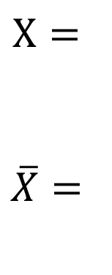
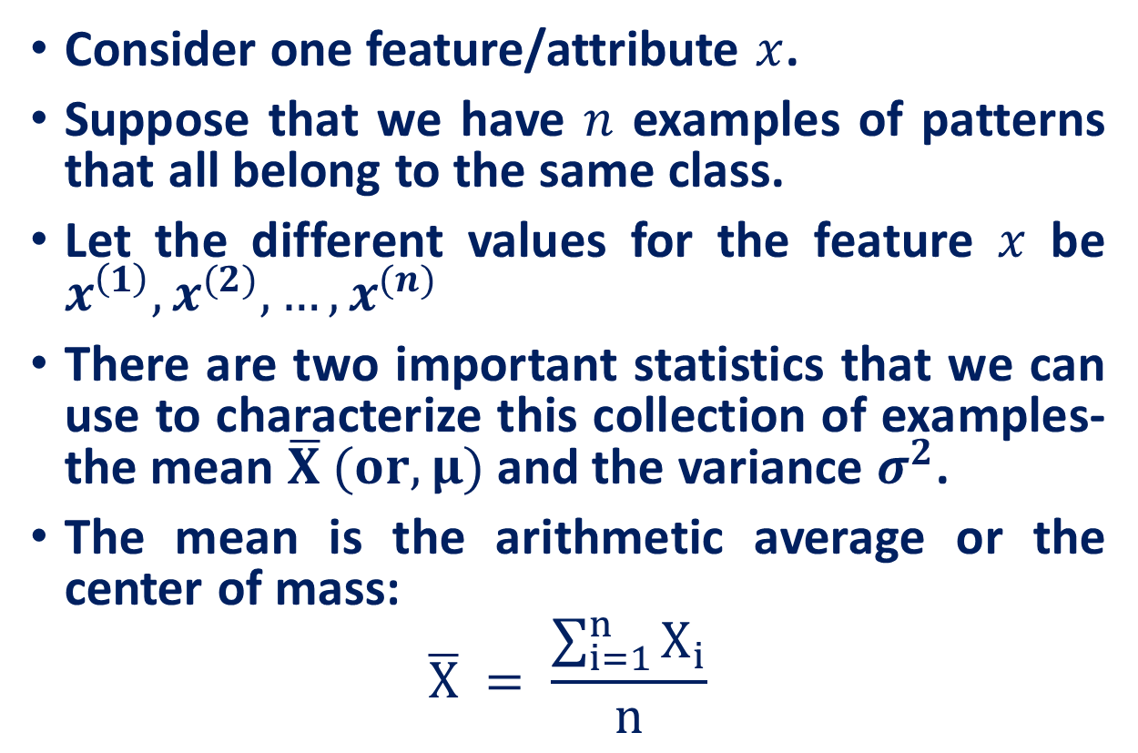

Mean, Variance and Standard Deviation
Consider one feature/attribute $x$.
Suppose that we have $n$ examples of patterns that all belong to the same class.
Let the different values for the feature $x$ be $x^{\left(1\right)}, x^{(2)}, …, x^{(n)}$
There are two important statistics that we can use to characterize this collection of examples- the mean $\overline{X} (or, μ)$ and the variance $σ^{2}$.
The mean is the arithmetic average or the center of mass:
$$\overline{X} = \frac{\sum_{i=1}^{n}{X_{i}}}{n}$$
Attribute
4
6
2
$$X=$$
$\overline{X}=$
4
$$\overline{X}$$

Slide 3

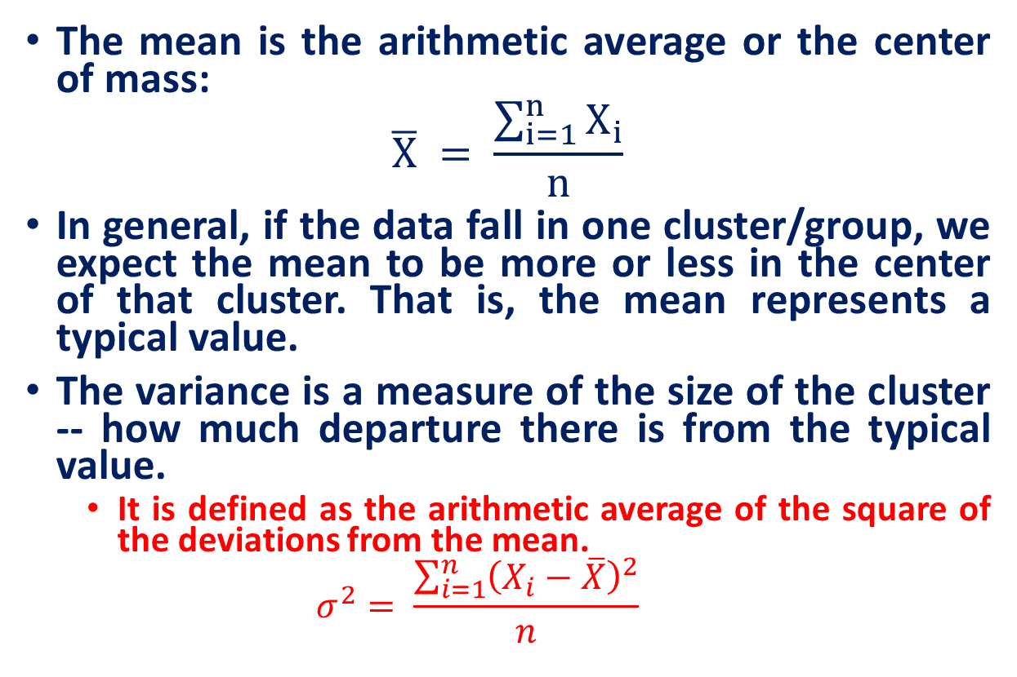

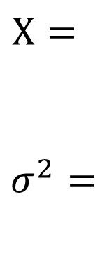
Mean, Variance and Standard Deviation
The mean is the arithmetic average or the center of mass:
$$\overline{X} = \frac{\sum_{i=1}^{n}{X_{i}}}{n}$$
In general, if the data fall in one cluster/group, we expect the mean to be more or less in the center of that cluster. That is, the mean represents a typical value.
The variance is a measure of the size of the cluster -- how much departure there is from the typical value.
It is defined as the arithmetic average of the square of the deviations from the mean.
$$σ^{2}= \frac{\sum_{i=1}^{n}{{\left(X_{i}−\overline{X}\right)}^{2}}}{n}$$
$$\overline{X}$$
Attribute 1
4
6
2
$$X=$$
$σ^{2}=$
$$\frac{{\left(4−4\right)}^{2}+{\left(6−4\right)}^{2}+{\left(2−4\right)}^{2}}{3}$$

Slide 4


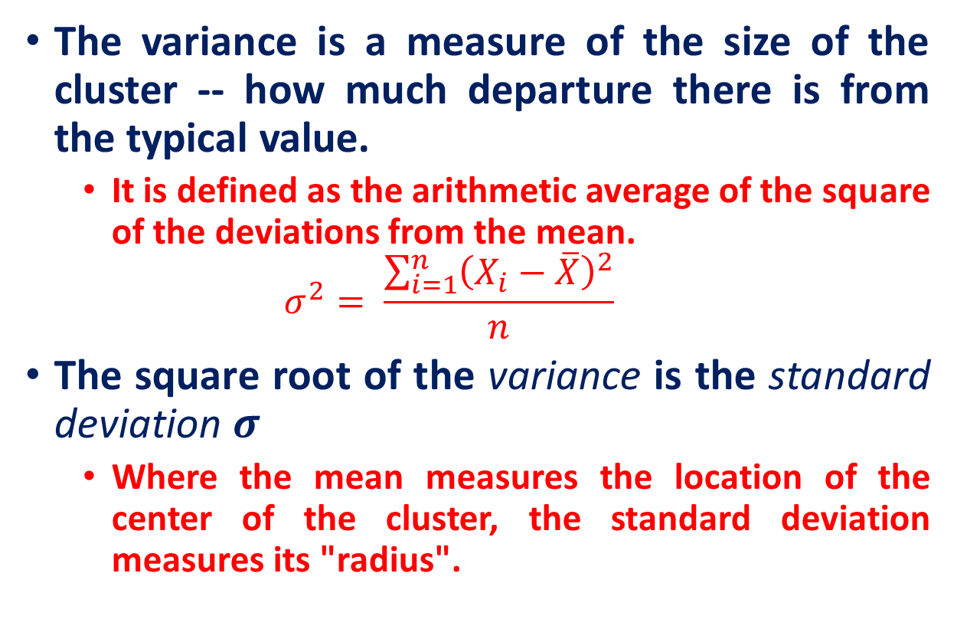


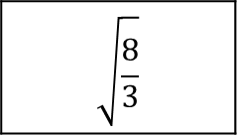
Mean, Variance and Standard Deviation
The variance is a measure of the size of the cluster -- how much departure there is from the typical value.
It is defined as the arithmetic average of the square of the deviations from the mean.
$$σ^{2}= \frac{\sum_{i=1}^{n}{{\left(X_{i}−\overline{X}\right)}^{2}}}{n}$$
The square root of the variance is the standard deviation $σ$
Where the mean measures the location of the center of the cluster, the standard deviation measures its "radius".
Attribute 1
4
6
2
$$\overline{X}$$
$$X=$$
$σ=$
$$\sqrt{\frac{8}{3}}$$
$$σ$$
$$σ$$
$$\overline{X}$$

Slide 5
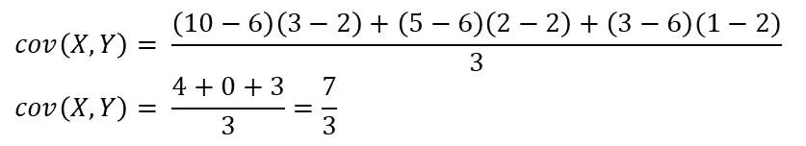
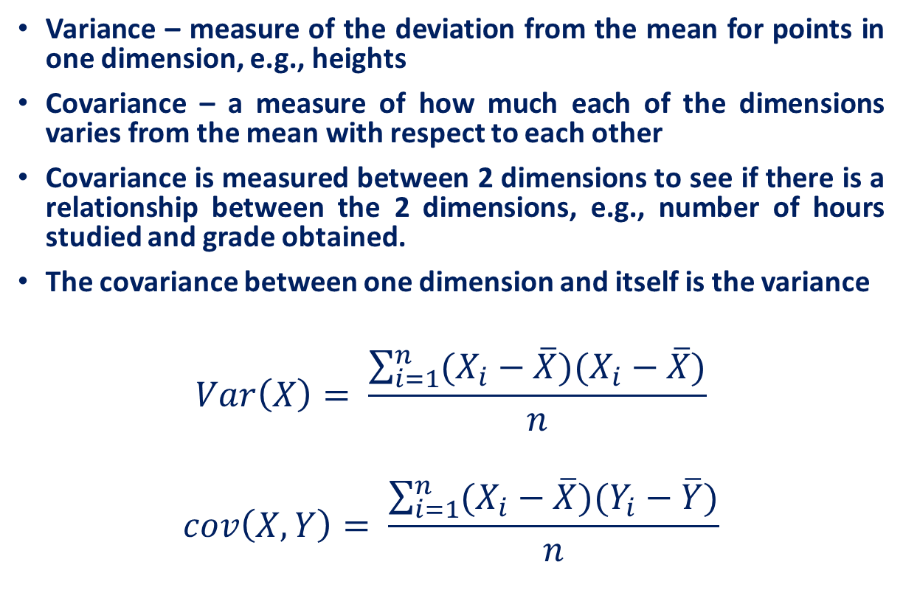
Covariance
Variance – measure of the deviation from the mean for points in one dimension, e.g., heights
Covariance – a measure of how much each of the dimensions varies from the mean with respect to each other
Covariance is measured between 2 dimensions to see if there is a relationship between the 2 dimensions, e.g., number of hours studied and grade obtained.
The covariance between one dimension and itself is the variance
$$Var\left(X\right)= \frac{\sum_{i=1}^{n}{(X_{i}−\overline{X})(X_{i}−\overline{X})}}{n}$$
$$cov\left(X, Y\right)= \frac{\sum_{i=1}^{n}{(X_{i}−\overline{X})(Y_{i}−\overline{Y})}}{n}$$
X | Y
10 | 3
5 | 2
3 | 1
Mean | 6 | 2
$$cov\left(X,Y\right)= \frac{\left(10−6\right)\left(3−2\right)+\left(5−6\right)\left(2−2\right)+\left(3−6\right)(1−2)}{3}$$
$$cov\left(X,Y\right)= \frac{4+0+3}{3}=\frac{7}{3}$$

Slide 6
Covariance
What is the interpretation of covariance calculations?
Say you have a 2-dimensional data set
X: number of hours studied for a subject
Y: marks obtained in that subject
And assume the covariance value (between X and Y) is: 104.53
What does this value mean?

Slide 7
Covariance
Exact value is not as important as its sign.
A positive value of covariance indicates that both dimensions increase or decrease together, e.g., as the number of hours studied increases, the grades in that subject also increase.
A negative value indicates while one increases the other decreases, or vice-versa, e.g., active social life vs. performance in CS Dept.
If covariance is zero: the two dimensions are independent of each other, e.g., heights of students vs. grades obtained in a subject.
Covariance calculations are used to find relationships between dimensions in high dimensional data sets (usually greater than 3) where visualization is difficult.

Slide 8
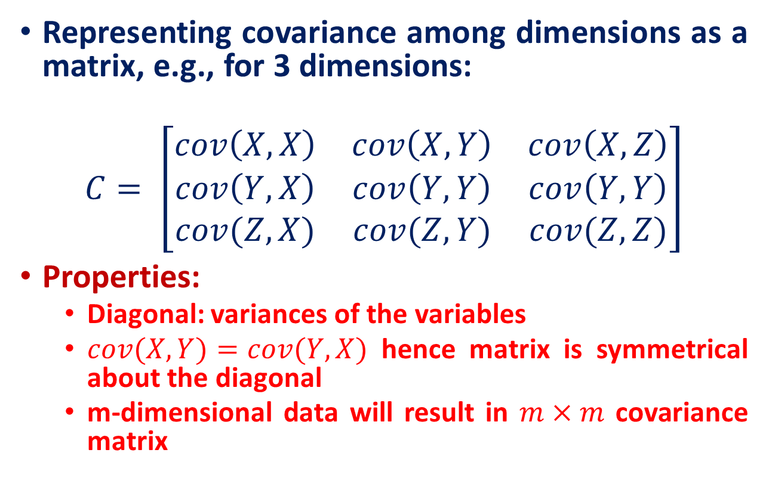
Covariance Matrix
Representing covariance among dimensions as a matrix, e.g., for 3 dimensions:
$$C= \left[\begin{matrix}cov\left(X,X\right) & cov\left(X,Y\right) & cov\left(X,Z\right) \\ cov\left(Y,X\right) & cov\left(Y,Y\right) & cov\left(Y,Y\right) \\ cov(Z,X) & cov(Z,Y) & cov(Z,Z)\end{matrix}\right]$$
Properties:
Diagonal: variances of the variables
$cov(X,Y)=cov(Y,X)$ hence matrix is symmetrical about the diagonal
m-dimensional data will result in $m×m$ covariance matrix

Slide 9
Data Dimensionality
From a theoretical point of view, increasing the number of features should lead to better performance.
In practice, the inclusion of more features leads to worse performance (i.e., curse of dimensionality).
The number of training examples required increases exponentially with dimensionality.

Slide 10
The curse of dimensionality
Real data usually have thousands, or millions of dimensions
E.g., web documents, where the dimensionality is the vocabulary of words
Facebook graph, where the dimensionality is the number of users
Huge number of dimensions causes problems
Data becomes very sparse, some algorithms become meaningless
The complexity of several algorithms depends on the dimensionality and they become infeasible.

Slide 11
Dimensionality Reduction
Usually the data can be described with fewer dimensions, without losing much of the meaning of the data.
The data reside in a space of lower dimensionality
Essentially, we assume that some of the data is noise, and we can approximate the useful part with a lower dimensionality space.
Dimensionality reduction does not just reduce the amount of data, it often brings out the useful part of the data

Slide 12
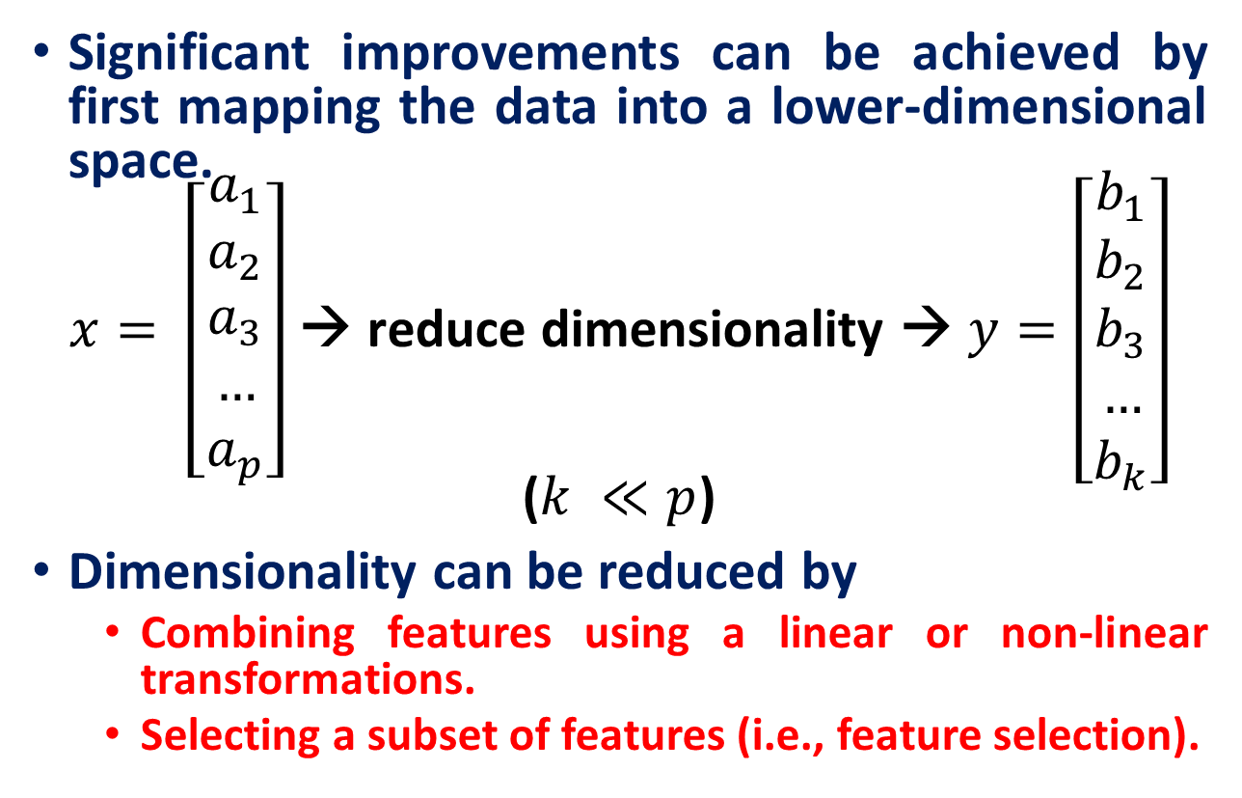
Dimensionality Reduction
Significant improvements can be achieved by first mapping the data into a lower-dimensional space.
$x= \left[\begin{aligned}a_{1} \\ a_{2} \\ a_{3} \\ … \\ a_{p}\end{aligned}\right]$ → reduce dimensionality → $y=\left[\begin{aligned}b_{1} \\ b_{2} \\ b_{3} \\ … \\ b_{k}\end{aligned}\right]$ ($k ≪p$)
Dimensionality can be reduced by
Combining features using a linear or non-linear transformations.
Selecting a subset of features (i.e., feature selection).

Slide 13
Dimensionality Reduction
Linear combinations are particularly attractive because they are simple to compute and analytically tractable.
Given $x ε ℝp$, the goal is to find an $p×k$matrix U such that:
$y = U^{T}x ε ℝ^{k}$ where $k≪p$
$x= \left[\begin{aligned}a_{1} \\ a_{2} \\ a_{3} \\ … \\ a_{p}\end{aligned}\right]$ → reduce dimensionality → $y=\left[\begin{aligned}b_{1} \\ b_{2} \\ b_{3} \\ … \\ b_{k}\end{aligned}\right]$ ($k <<p$)

Slide 14
Example of a problem
We collected p parameters about 100 students:
Height
Weight
Hair color
Average grade
…
We want to find the most important parameters that best describe a student.

Slide 15
Example of a problem
Each student is described using a vector length p:
(180, 70,’ purple’, 84,…)
We have n = 100 such vectors. Let’s put them in one matrix, where each column is one student vector.
So we have a$p×n$matrix. This will be the input of our problem.

Slide 16
Which parameters can we ignore?
Constant parameter (number of heads)
1,1,…,1.
Constant parameter with some noise -(thickness of hair)
0.003, 0.005,0.002,….,0.0008 → low variance
Parameter that is linearly dependent on other parameters (head size and height)
$Z=aX +bY$

Slide 17
Which parameters do we want to keep?
Parameter that doesn’t depend on others (e.g. eye color), i.e. uncorrelated.
• Parameter that changes a lot (grades)
The opposite of noise
High variance
Questions:
How we describe ‘most important’ features using math?
Variance
How do we represent our data so that the most important features can be extracted easily?
Change of basis

Slide 18
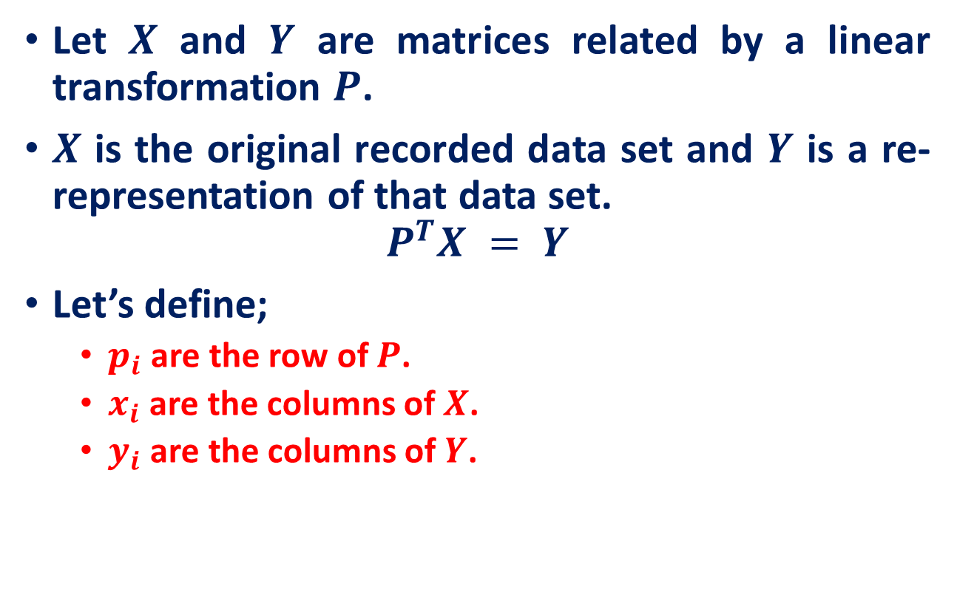
Change of Basis !!!
Let $X$ and $Y$ are matrices related by a linear transformation $P$.
$X$ is the original recorded data set and $Y$ is a re-representation of that data set.
$$P^{T}X = Y$$
Let’s define;
$p_{i}$ are the row of $P$.
$x_{i}$ are the columns of $X$.
$y_{i}$ are the columns of $Y$.

Slide 19
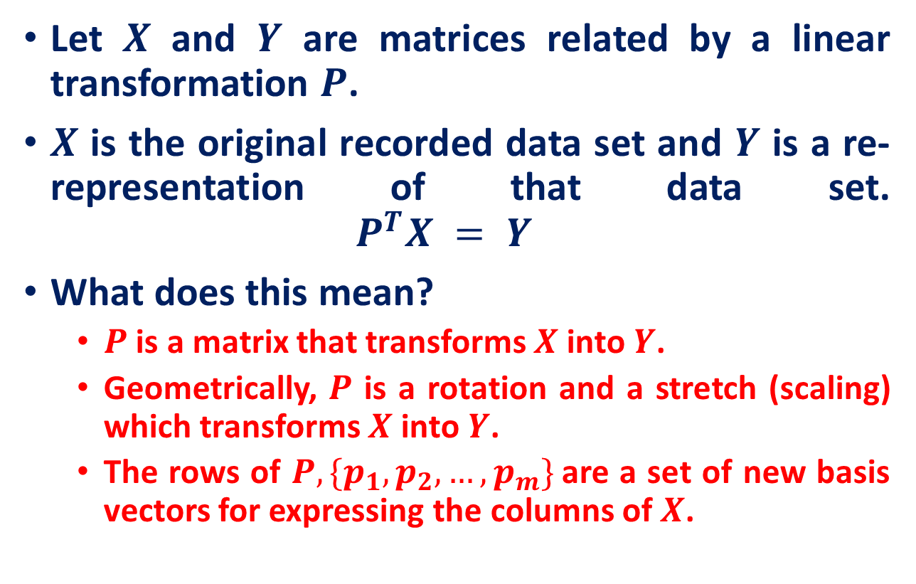
Change of Basis !!!
Let $X$ and $Y$ are matrices related by a linear transformation $P$.
$X$ is the original recorded data set and $Y$ is a re-representation of that data set. $P^{T}X = Y$
What does this mean?
$P$ is a matrix that transforms $X$ into $Y$.
Geometrically, $P$ is a rotation and a stretch (scaling) which transforms $X$ into $Y$.
The rows of $P, \{p_{1}, p_{2}, …,p_{m}\}$are a set of new basis vectors for expressing the columns of $X$.

Slide 20
Change of Basis !!!
Changing the basis doesn’t change the data – only its representation.
Changing the basis is actually projecting the data vectors on the basis vectors.
Geometrically, P is a rotation and a stretch of X.
If P basis is orthonormal (length = 1) then the transformation P is only a rotation.

Slide 21
What does “best express” the data mean ?!!!
As we’ve said before, we want to filter out noise and extract the relevant information from the given data set.
Hence, the representation we are looking for will decrease both noise and redundancy in the data set at hand.

Slide 22
Principal Component Analysis Maximum Variance Projection Method

Slide 23
Principal component analysis
Principal component analysis (PCA) is a way to reduce data dimensionality by finding a new set of variables, smaller than the original set of variables, that nonetheless retains most of the sample's information.
The new variables, called principal components (PCs), are uncorrelated, and are ordered by the fraction of the total information each retains.
PCA projects the data in the least square sense– it captures big (principal) variability in the data and ignores small variability.

Slide 24
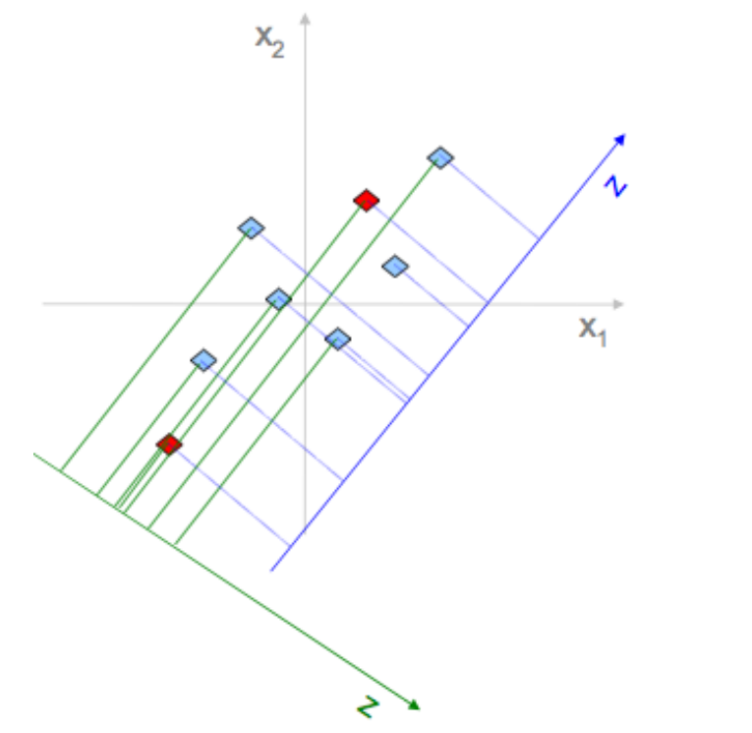
Why Variance
Example: reduce 2-dimensional data to 1d
$\left\{x_{1},x_{2}\right\} ⟶e$(along new axis)
Pick E to maximize variability
Reduces cases when two points are close in e-space but very far in ($x,y$)-space
Minimizes distances between original points and their projectons

Slide 25
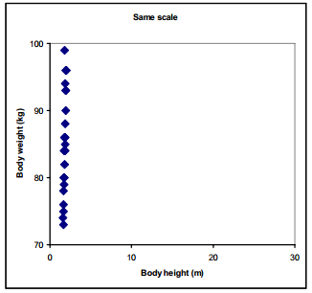
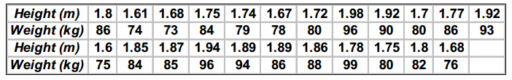
Pre-Processing of Data
Scaling
Variables often have substantially different numerical range
A variable with large range has a large variance, whereas a variable with a small range has a small variance
Since PCA is a maximum variance projection method, if follows that a variable with a large variance is more likely to be expressed in modeling than a low-variance variable
Example

Slide 26
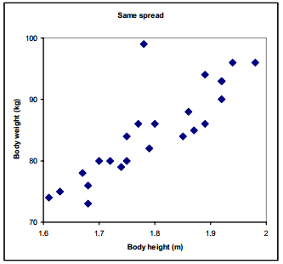
Pre-Processing of Data - Scaling
We can see that the data points only spread in the vertical direction because body weight has much larger numerical range than body height.
Lets zoom the Figure
There is strong correlation between body height and body weight, except for one outlier in the data.

Slide 27
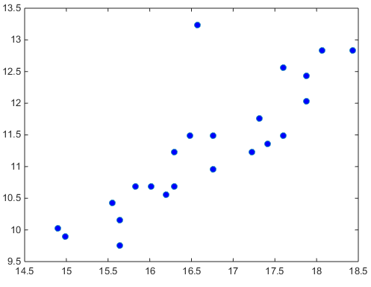
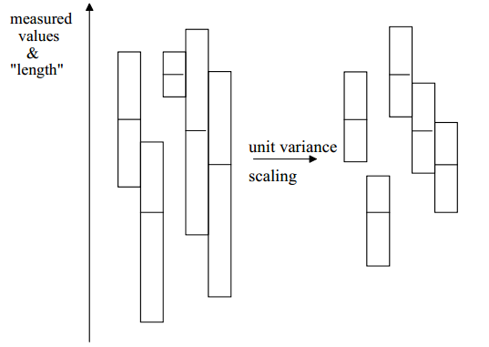
Pre-Processing of Data - Scaling
Solution:
Scaling : In order to give both variable, body weight and height, equal weight in the data, we standardized (scaling or weighting) them.
There are may ways, but the most common technique is unit variance.
Unit variance
For each variable, calculate the standard deviation ($s_{k})$
Scaling weight = inverse of standard deviation $\left(\frac{1}{s_{k}}\right)$

Slide 28
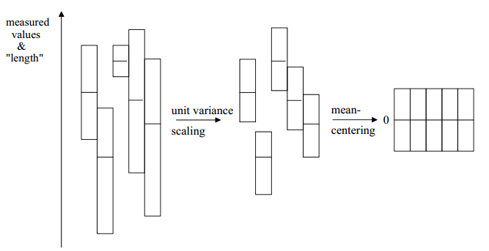
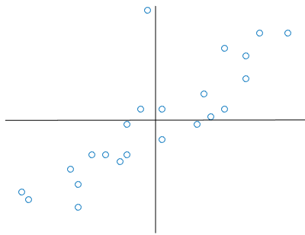
Pre-Processing of Data
Mean-Centering
This improves the interpretability of the model.
Calculate average value of each variable and then subtract from the data.
Normalization is not needed.
However, mean centering is essential for performing Principal Component Analysis, as it gives direction of variability across the mean of the samples by creating the covariance matrix.
Without centering, one would be looking at variations about the origin.

Slide 29
Geometric picture of principal components (PCs)
Here is a small dataset of opponents we have to fight.
Each data object is represented by its X-Y location in 2D space.
A randomly chosen object is show in orange.
weight
height

Slide 30
Geometric picture of principal components (PCs)
Let us z-normalize the data…
Each data object is still represented by its X-Y location in 2D space

Slide 31
Geometric picture of principal components (PCs)
Let us rotate the axis to find the highest variance
PC1

Slide 32
Geometric picture of principal components (PCs)
The idea is to rotate the axes so that the new axes (also called the principal components, i.e., PCs for short) are such that the variance of the data on each axis goes down from axis to axis.
The first new axis is called the first principal component (PC1) and it is in the direction of the greatest variance in the data.
Each new axis is constructed orthogonal to the previous ones and along the direction with the largest remaining variance.
PC1
PC2

Slide 33
Geometric picture of principal components (PCs)
Each data object is still represented by its location in 2D space.
However, instead of X-Y space, we are now in PC1-PC2 space.
Note that for our orange example, the value in PCI is large, and in PC2 is small.
This is true on average for all data points. Moreover, it is true by definition, this is what PCA does!
PC1
PC2

Slide 34
Geometric picture of principal components (PCs)
We can project the data onto just the PC1 axis
PC1
PC2

Slide 35
Geometric picture of principal components (PCs)
PC1
We can project the data onto just the PC1 axis. This means that PC2 no longer exist
This is a general trick.
Starting with any N dimensions, we can do PCA, and keep just n dimensions, n <=N, as use the n dimensions for clustering, classifying, indexing, plotting etc.

Slide 36
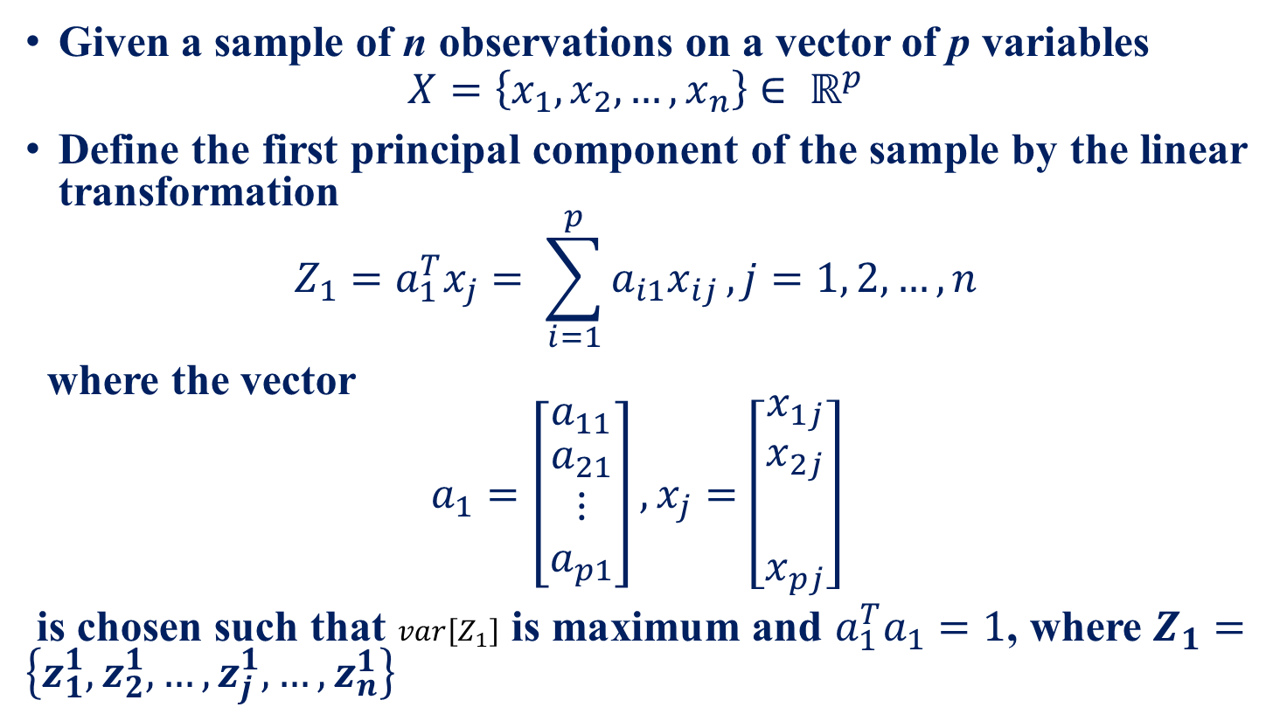
Algebraic definition of PCs
Given a sample of n observations on a vector of p variables
$$X=\left\{x_{1},x_{2},…, x_{n}\right\}∈ ℝ^{p}$$
Define the first principal component of the sample by the linear transformation
$$Z_{1}=a_{1}^{T}x_{j}= \sum_{i=1}^{p}{a_{i1}x_{ij}}, j=1, 2, …, n$$
where the vector
$$a_{1}=\left[\begin{matrix}a_{11} \\ \begin{aligned}a_{21} \\ ⋮ \\ a_{p1}\end{aligned}\end{matrix}\right],x_{j}=\left[\begin{matrix}x_{1j} \\ \begin{aligned}x_{2j} \\ \\ x_{pj}\end{aligned}\end{matrix}\right]$$
is chosen such that $var\left[Z_{1}\right]$ is maximum and $a_{1}^{T}a_{1}=1$, where $Z_{1}=\left\{z_{1}^{1}, z_{2}^{1},…, z_{j}^{1}, …, z_{n}^{1}\right\}$

Slide 37
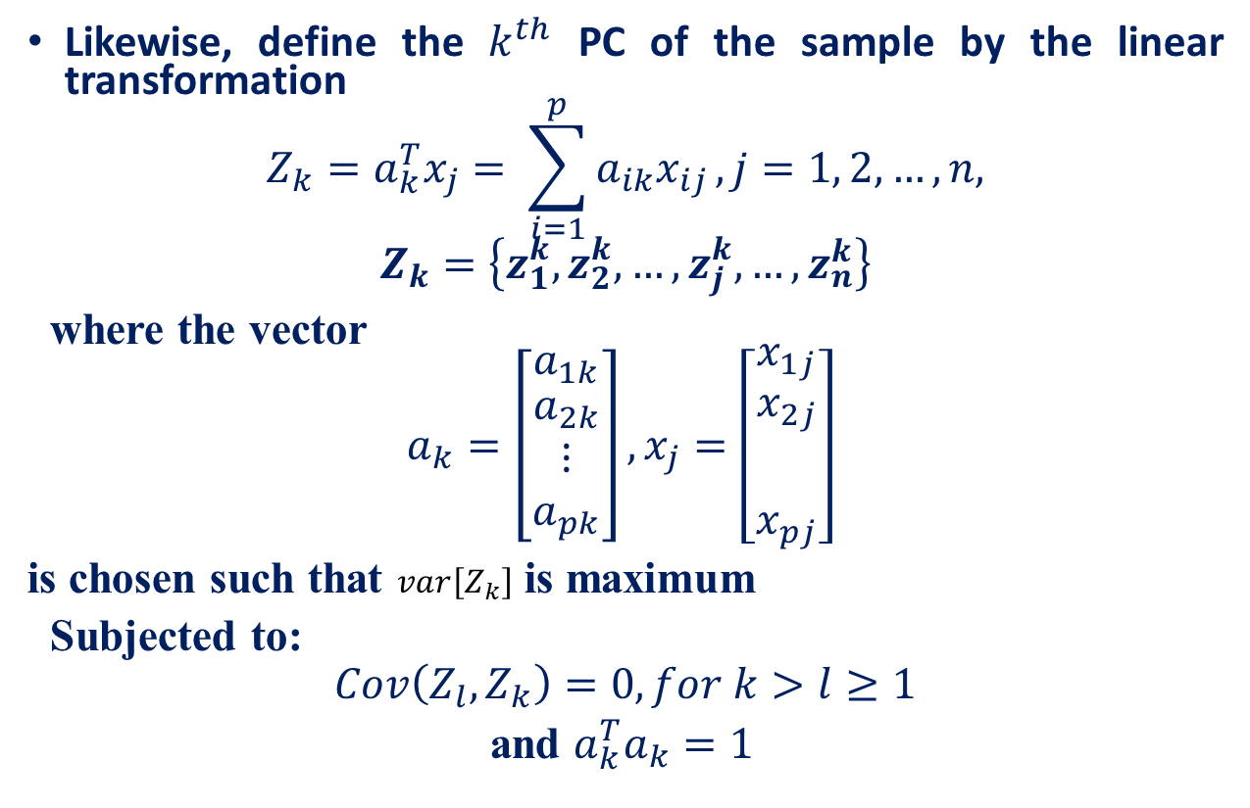
Algebraic definition of PCs
Likewise, define the $k^{th}$ PC of the sample by the linear transformation
$$Z_{k}=a_{k}^{T}x_{j}= \sum_{i=1}^{p}{a_{ik}x_{ij}}, j=1, 2, …, n,$$
$$Z_{k}=\left\{z_{1}^{k}, z_{2}^{k},…, z_{j}^{k}, …, z_{n}^{k}\right\}$$
where the vector
$$a_{k}=\left[\begin{matrix}a_{1k} \\ \begin{aligned}a_{2k} \\ ⋮ \\ a_{pk}\end{aligned}\end{matrix}\right],x_{j}=\left[\begin{matrix}x_{1j} \\ \begin{aligned}x_{2j} \\ \\ x_{pj}\end{aligned}\end{matrix}\right]$$
is chosen such that $var\left[Z_{k}\right]$ is maximum
Subjected to:
$$Cov\left(Z_{l},Z_{k}\right)=0, for k>l≥1$$
and $a_{k}^{T}a_{k}=1$

Slide 38

Algebraic derivation of coefficient vectors $a_{1}$
To find $a_{1}$first note that
$$var\left(z_{1}\right)=\frac{1}{n} \sum_{i=1}^{n}{{\left(a_{1}^{T}x_{i}−a_{1}^{T} \overline{x}\right)}^{2}}$$

Slide 39
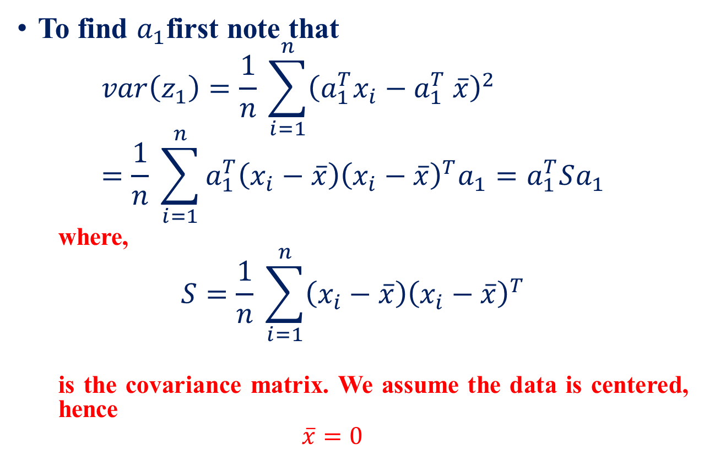
Algebraic derivation of coefficient vectors $a_{1}$
To find $a_{1}$first note that
$$var\left(z_{1}\right)=\frac{1}{n} \sum_{i=1}^{n}{{\left(a_{1}^{T}x_{i}−a_{1}^{T} \overline{x}\right)}^{2}} =\frac{1}{n} \sum_{i=1}^{n}{a_{1}^{T}\left(x_{i}−\overline{x}\right){\left(x_{i}−\overline{x}\right)}^{T}a_{1}}=a_{1}^{T}Sa_{1}$$
where,
$$S=\frac{1}{n} \sum_{i=1}^{n}{\left(x_{i}−\overline{x}\right){\left(x_{i}−\overline{x}\right)}^{T}}$$
is the covariance matrix. We assume the data is centered, hence
$$\overline{x}=0$$

Slide 40
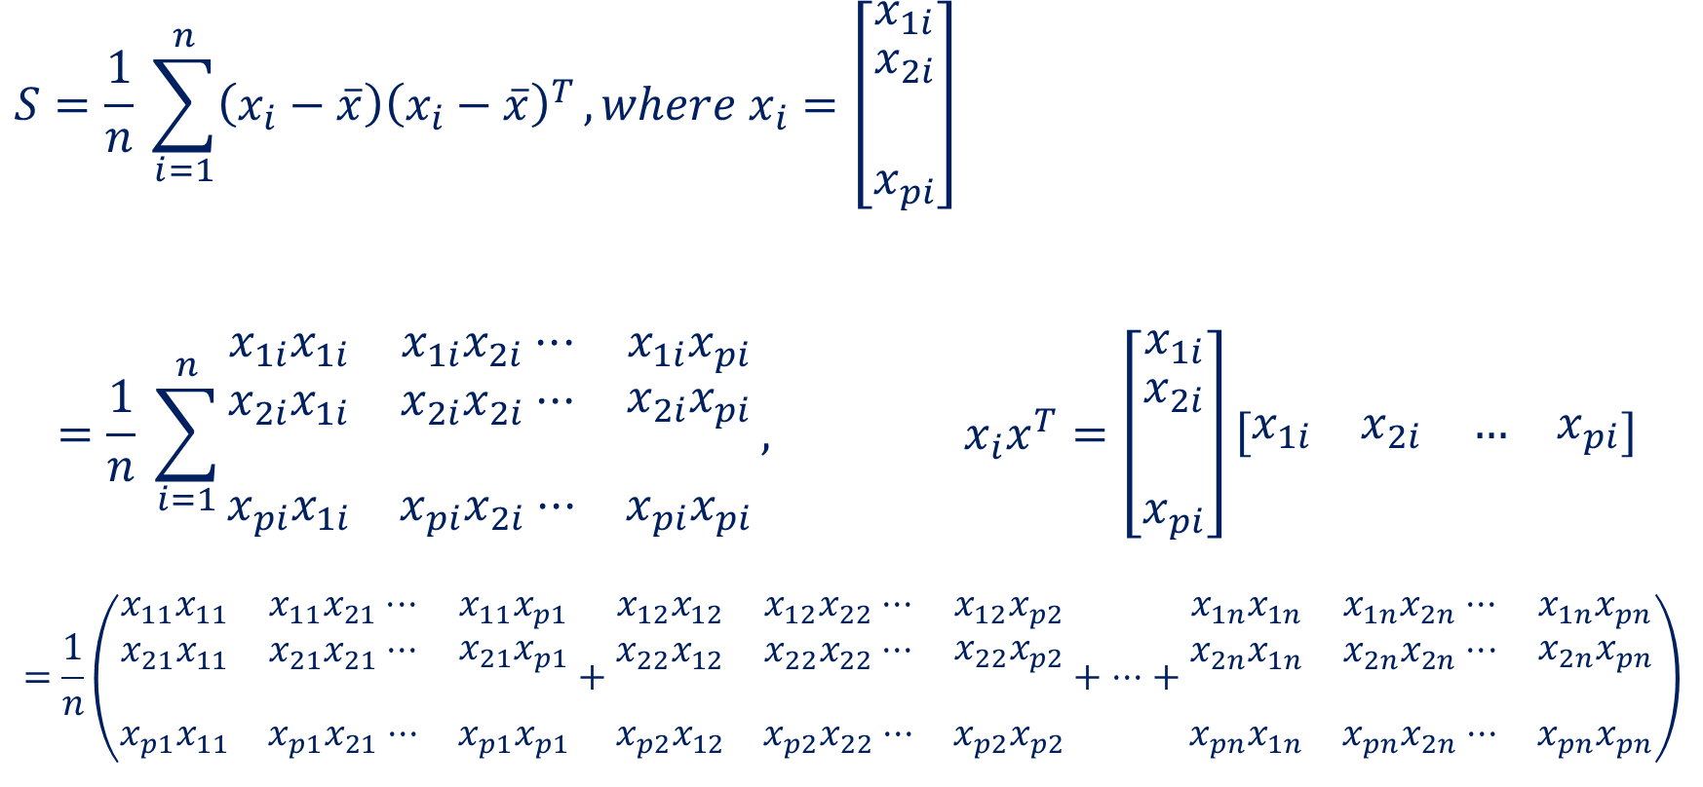
Algebraic derivation of coefficient vectors $a_{1}$
$$S=\frac{1}{n} \sum_{i=1}^{n}{\left(x_{i}−\overline{x}\right){\left(x_{i}−\overline{x}\right)}^{T}}, where x_{i}=\left[\begin{matrix}x_{1i} \\ \begin{aligned}x_{2i} \\ \\ x_{pi}\end{aligned}\end{matrix}\right]$$
$$=\frac{1}{n} \sum_{i=1}^{n}{\begin{matrix}x_{1i}x_{1i} & x_{1i}x_{2i}⋅⋅⋅ & x_{1i}x_{pi} \\ \begin{aligned}x_{2i}x_{1i} \\ \end{aligned} & \begin{aligned}x_{2i}x_{2i}⋅⋅⋅ \\ \end{aligned} & \begin{aligned}x_{2i}x_{pi} \\ \end{aligned} \\ x_{pi}x_{1i} & x_{pi}x_{2i}⋅⋅⋅ & x_{pi}x_{pi}\end{matrix}}, x_{i}x^{T}=\left[\begin{matrix}x_{1i} \\ \begin{aligned}x_{2i} \\ \\ x_{pi}\end{aligned}\end{matrix}\right]\left[\begin{matrix}x_{1i} & x_{2i} & … & x_{pi}\end{matrix}\right]$$
$$=\frac{1}{n}\left(\begin{matrix}x_{11}x_{11} & x_{11}x_{21}⋅⋅⋅ & x_{11}x_{p1} \\ \begin{aligned}x_{21}x_{11} \\ \end{aligned} & \begin{aligned}x_{21}x_{21}⋅⋅⋅ \\ \end{aligned} & \begin{aligned}x_{21}x_{p1} \\ \end{aligned} \\ x_{p1}x_{11} & x_{p1}x_{21}⋅⋅⋅ & x_{p1}x_{p1}\end{matrix}+\begin{matrix}x_{12}x_{12} & x_{12}x_{22}⋅⋅⋅ & x_{12}x_{p2} \\ \begin{aligned}x_{22}x_{12} \\ \end{aligned} & \begin{aligned}x_{22}x_{22}⋅⋅⋅ \\ \end{aligned} & \begin{aligned}x_{22}x_{p2} \\ \end{aligned} \\ x_{p2}x_{12} & x_{p2}x_{22}⋅⋅⋅ & x_{p2}x_{p2}\end{matrix}+ ⋅⋅⋅+ \begin{matrix}x_{1n}x_{1n} & x_{1n}x_{2n}⋅⋅⋅ & x_{1n}x_{pn} \\ \begin{aligned}x_{2n}x_{1n} \\ \end{aligned} & \begin{aligned}x_{2n}x_{2n}⋅⋅⋅ \\ \end{aligned} & \begin{aligned}x_{2n}x_{pn} \\ \end{aligned} \\ x_{pn}x_{1n} & x_{pn}x_{2n}⋅⋅⋅ & x_{pn}x_{pn}\end{matrix}\right)$$

Slide 41
Algebraic derivation of coefficient vectors $a_{1}$
$$=\frac{1}{n}\left(\begin{matrix}x_{11}x_{11} & x_{11}x_{21}⋅⋅⋅ & x_{11}x_{p1} \\ \begin{aligned}x_{21}x_{11} \\ \end{aligned} & \begin{aligned}x_{21}x_{21}⋅⋅⋅ \\ \end{aligned} & \begin{aligned}x_{21}x_{p1} \\ \end{aligned} \\ x_{p1}x_{11} & x_{p1}x_{21}⋅⋅⋅ & x_{p1}x_{p1}\end{matrix}+\begin{matrix}x_{12}x_{12} & x_{12}x_{22}⋅⋅⋅ & x_{12}x_{p2} \\ \begin{aligned}x_{22}x_{12} \\ \end{aligned} & \begin{aligned}x_{22}x_{22}⋅⋅⋅ \\ \end{aligned} & \begin{aligned}x_{22}x_{p2} \\ \end{aligned} \\ x_{p2}x_{12} & x_{p2}x_{22}⋅⋅⋅ & x_{p2}x_{p2}\end{matrix}+ ⋅⋅⋅+ \begin{matrix}x_{1n}x_{1n} & x_{1n}x_{2n}⋅⋅⋅ & x_{1n}x_{pn} \\ \begin{aligned}x_{2n}x_{1n} \\ \end{aligned} & \begin{aligned}x_{2n}x_{2n}⋅⋅⋅ \\ \end{aligned} & \begin{aligned}x_{2n}x_{pn} \\ \end{aligned} \\ x_{pn}x_{1n} & x_{pn}x_{2n}⋅⋅⋅ & x_{pn}x_{pn}\end{matrix}\right)$$
$$S=\left(\begin{matrix}Cov(A_{1},A_{1}) & Cov(A_{1},A_{2})⋅⋅⋅ & Cov(A_{1},A_{p}) \\ \begin{aligned}Cov(A_{2},A_{1}) \\ \end{aligned} & \begin{aligned}Cov(A_{2},A_{2})⋅⋅⋅ \\ \end{aligned} & \begin{aligned}Cov(A_{2},A_{p}) \\ \end{aligned} \\ Cov(A_{p},A_{1}) & Cov(A_{p},A_{2})⋅⋅⋅ & Cov(A_{p},A_{p})\end{matrix}\right), where A_{k}is the kth attribute$$
$$var\left(z_{1}\right)=a_{1}^{T}\left(\frac{1}{n} \sum_{i=1}^{n}{\left(x_{i}−\overline{x}\right){\left(x_{i}−\overline{x}\right)}^{T}}\right)a_{1}=a_{1}^{T}Sa_{1}$$

Slide 42
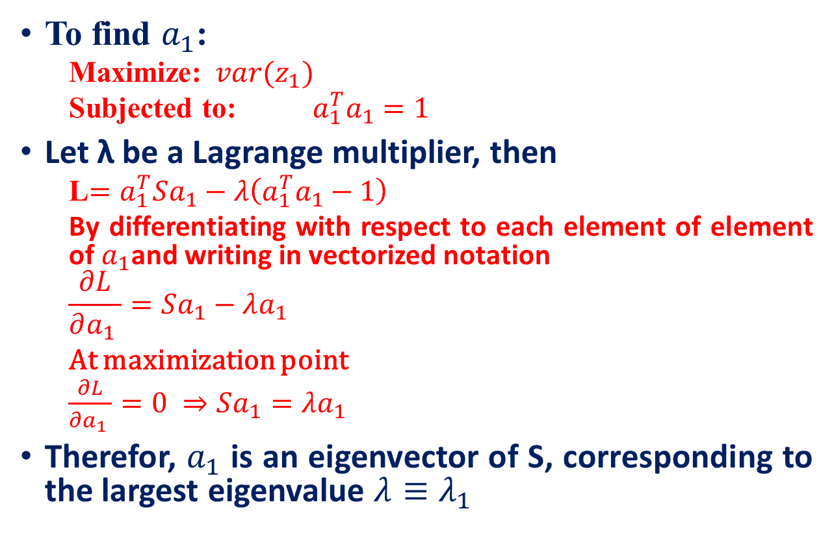
Algebraic derivation of coefficient vectors $a_{k}$
To find $a_{1}$:
Maximize: $var(z_{1})$
Subjected to: $a_{1}^{T}a_{1}=1$
Let λ be a Lagrange multiplier, then
L$=a_{1}^{T}Sa_{1}−λ\left(a_{1}^{T}a_{1}−1\right)$
By differentiating with respect to each element of element of $a_{1}$and writing in vectorized notation
$$\frac{∂L}{∂a_{1} }=Sa_{1}−λa_{1}$$ At maximization point
$\frac{∂L}{∂a_{1} }=0 ⇒Sa_{1}=λa_{1}$
Therefor, $a_{1}$ is an eigenvector of S, corresponding to the largest eigenvalue $λ≡λ_{1}$

Slide 43
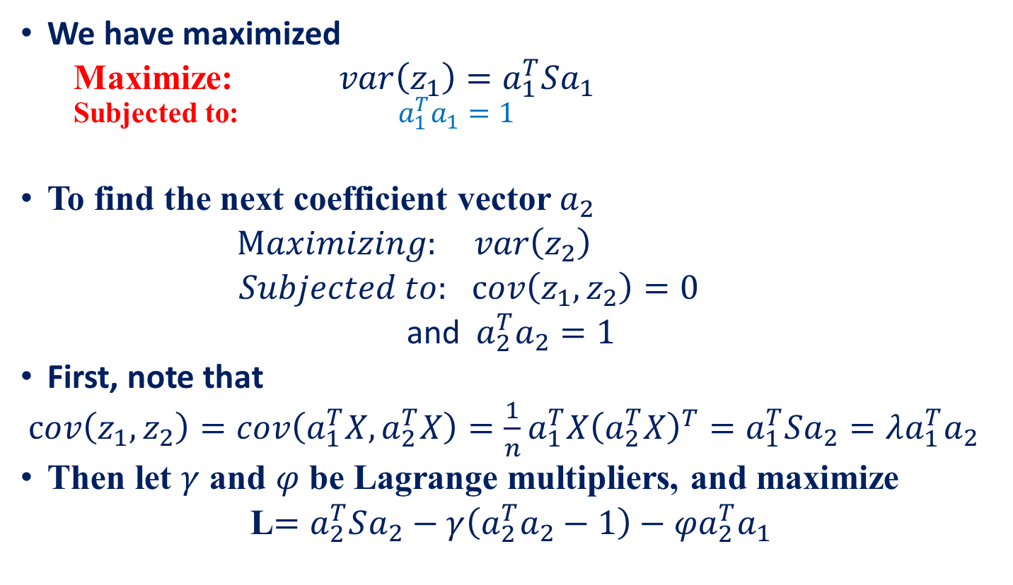
Algebraic derivation of coefficient vectors $a_{k}$
We have maximized
Maximize: $var\left(z_{1}\right)=a_{1}^{T}Sa_{1}$
Subjected to: $a_{1}^{T}a_{1}=1$
To find the next coefficient vector $a_{2}$
$Maximizing: var\left(z_{2}\right)$
$Subjected to:$ $cov\left(z_{1},z_{2}\right)=0$
and${ a}_{2}^{T}a_{2}=1$
First, note that
$cov\left(z_{1},z_{2}\right)=cov\left(a_{1}^{T}X, a_{2}^{T}X\right)=\frac{1}{n}a_{1}^{T}X{\left(a_{2}^{T}X\right)}^{T}=a_{1}^{T}Sa_{2}=λa_{1}^{T}a_{2}$
Then let $γ$ and $φ$ be Lagrange multipliers, and maximize
L$=a_{2}^{T}Sa_{2}−γ\left(a_{2}^{T}a_{2}−1\right)−φa_{2}^{T}a_{1}$
uncorrelated

Slide 44
Algebraic derivation of coefficient vectors $a_{k}$
L$=a_{2}^{T}Sa_{2}−λ\left(a_{2}^{T}a_{2}−1\right)−φa_{2}^{T}a_{1}$
$$\frac{∂L}{∂a_{2}}=Sa_{2}−γa_{2}−φa_{1}$$
At maximization point $\frac{∂L}{∂a_{2}}=0$,
$⇒Sa_{2}−γa_{2}−φa_{1}=0$
By multiplying both side with $a_{1}^{T}$
$⇒a_{1}^{T}Sa_{2}−γ{a_{1}^{T}a}_{2}−φa_{1}^{T}a_{1}=0$
$$⇒{λa}_{1}^{T}a_{2}−γ{a_{1}^{T}a}_{2}−φa_{1}^{T}a_{1}=0$$
$${⇒λa}_{1}^{T}a_{2}−γ{a_{1}^{T}a}_{2}−φa_{1}^{T}a_{1}=0⇒λ.0−γ.0−φa_{1}^{T}a_{1}=0⇒φ=0$$

Slide 45
Algebraic derivation of coefficient vectors $a_{k}$
We find that $a_{2}$ is also an eigenvector of S
whose eigenvalue $λ=λ_{2}$ is the second largest.
In general
$$var\left(z_{k}\right)=a_{k}^{T}Sa_{k}=λ_{k}$$
The $k^{th}$ largest eigenvalue of S is the variance of the $k^{th}$ PC.
The $k^{th}$ PC retains the $k^{th}$ greatest fraction of the variation in the sample.

Slide 46
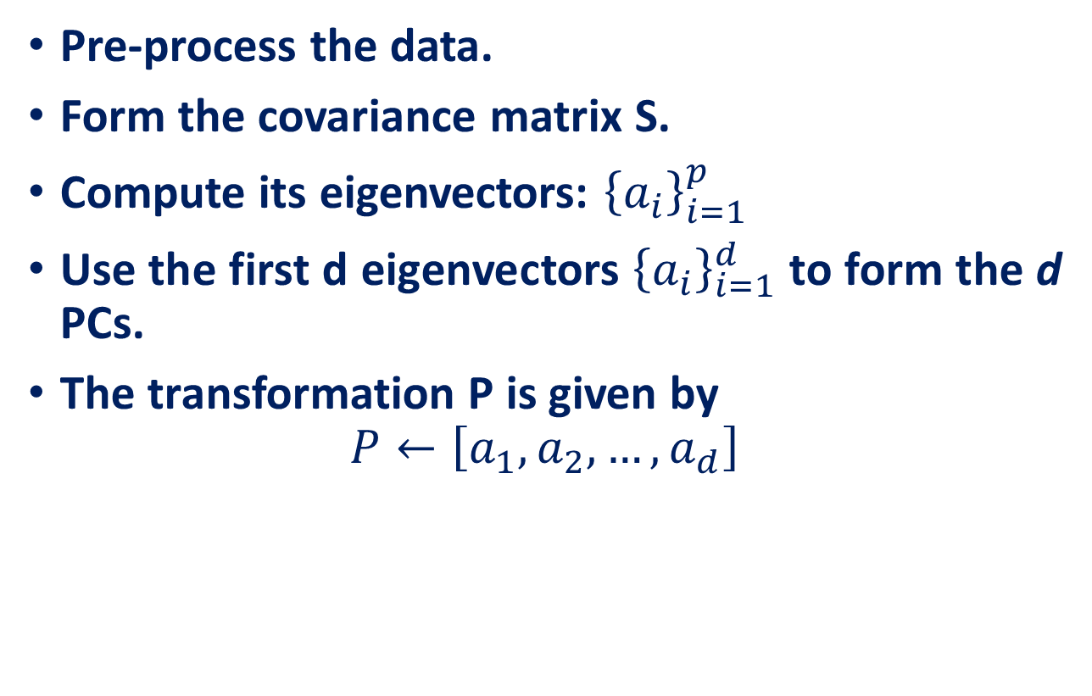
Main steps for computing PCs
Pre-process the data.
Form the covariance matrix S.
Compute its eigenvectors: ${\left\{a_{i}\right\}}_{i=1}^{p}$
Use the first d eigenvectors ${\left\{a_{i}\right\}}_{i=1}^{d}$ to form the d PCs.
The transformation P is given by
$$P←\left[a_{1}, a_{2},…, a_{d}\right]$$

Slide 47
PCA Assumptions
PCA assumes that all basis vectors $\{p_{1}, . . . , p_{m}\}$are orthonormal.
Hence, in the language of linear algebra, PCA assumes P is an orthonormal matrix.
Secondly, PCA assumes the directions with the largest variances are the most “important” or in other words, most principal.

Slide 48
PCA Example
Data
PCA process –STEP 1
Zero Mean data
2.5 | 0.5 | 2.2 | 1.9 | 3.1 | 2.3 | 2 | 1 | 1.5 | 1.1
2.4 | 0.7 | 2.9 | 2.2 | 3.0 | 2.7 | 1.6 | 1.1 | 1.6 | 0.9
0.69 | -1.31 | 0.39 | 0.09 | 1.29 | 0.49 | 0.19 | -0.81 | -0.31 | -0.71
0.49 | -1.21 | 0.99 | 0.29 | 1.09 | 0.79 | -0.31 | -0.81 | -0.31 | -1.01

Slide 49
PCA process –STEP 2
Calculate the covariance matrix
cov = $\begin{matrix}\text{0}\text{.616555556} & \text{0}\text{.615444444} \\ 0.\text{615444444} & 0\text{.716555556}\end{matrix}$
Since the non-diagonal elements in this covariance matrix are positive, we should expect that both the x and y variable increase together

Slide 50
PCA process –STEP 3
Calculate the eigenvectors and eigenvalues of the covariance matrix
eigenvalues = $\begin{matrix}\text{0}\text{.0490833989 } \\ \text{1.28402771}\text{00} \end{matrix}$
eigenvectors = $\begin{matrix}\text{−}\text{0}\text{.735178656} & \text{−}\text{0}\text{.677873399} \\ \text{ 0}\text{.677873399} & \text{−}\text{0}\text{.735178656}\end{matrix}$

Slide 51
PCA process –STEP 3
Once eigenvectors are found from the covariance matrix, the next step is to order them by eigenvalue, highest to lowest. This gives you the components in order of significance.

Slide 52
PCA process –STEP 4
Feature Vector
Feature Vector = (eig1 eig2 eig3 … eign)
We can either form a feature vector with both of the eigenvectors:
-.677873399 -.735178656
-.735178656 .677873399
Or, we can choose to leave out the smaller, less significant component and only have a single column:
- 0.677873399
- 0.735178656

Slide 53
PCA process –STEP 5
Reduce dimensionality and form feature vector the eigenvector with the highest eigenvalue is the principal component of the data set.

Slide 54
Reconstruction of Original Data
Reconstruction

Slide 55
Optimality property of PCA
Main theoretical result:
The matrix P consisting of the first d eigenvectors of the covariance matrix S solves the following min problem:
PCA projection minimizes the reconstruction error among all linear projections of size d.
reconstruction error

Slide 56
Reference
Feature Extraction, K. Ramachandra Murthy
A Tutorial on Principal Component Analysis, Aly A. Farag Shireen Elhabian University of Louisville, CVIP Lab

